Slide 1

Overview of Carbon Removal Activities
Elizabeth Huber, Director
Siting, Transmission and Environmental Protection Division
Elizabeth.Huber@energy.ca.gov
Virginia Lew, Manager
Energy Research and Development Division
Virginia.Lew@energy.ca.gov

Slide 2

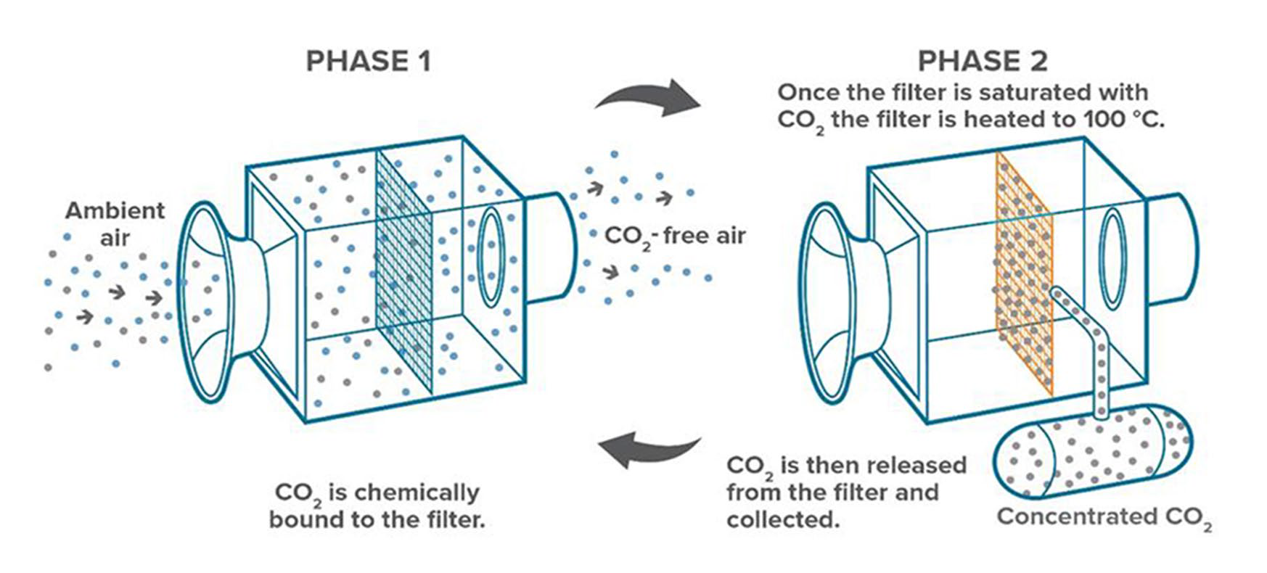
Carbon Removal Innovation Support Program (CRISP)
AB 209 (The Energy and Climate Change budget bill, Chapter 251, Statutes of 2022) mandated a program to incentivize Direct Air Capture (DAC) development in California
DAC technologies include mechanical and chemical processes that capture atmospheric carbon dioxide as opposed to point-
source carbon capture
Tentative Program Elements | Tentative Schedule
Research Test Center* - facilitate pilot testing of DAC technologies | Summer 2023
Cost Share for Federal Grants | Released
Small Scale Demonstrations of DAC Technologies | Late 2023
Community Engagement and Outreach - facilitate education and community needs | Late 2023
Technical Assistance & Admin | On-going
TOTAL $75M
* Options considered:
Building center in California
Grants or vouchers for tech providers to test at existing test facilities (NETL)
CRISP Web Link

Slide 3
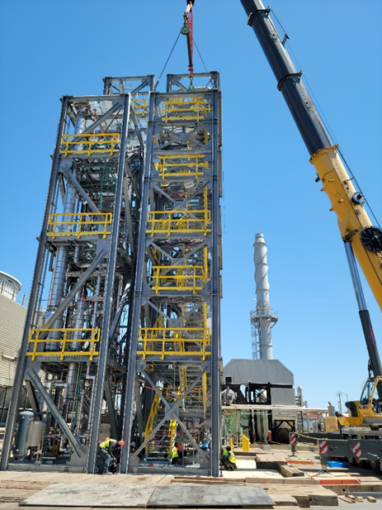
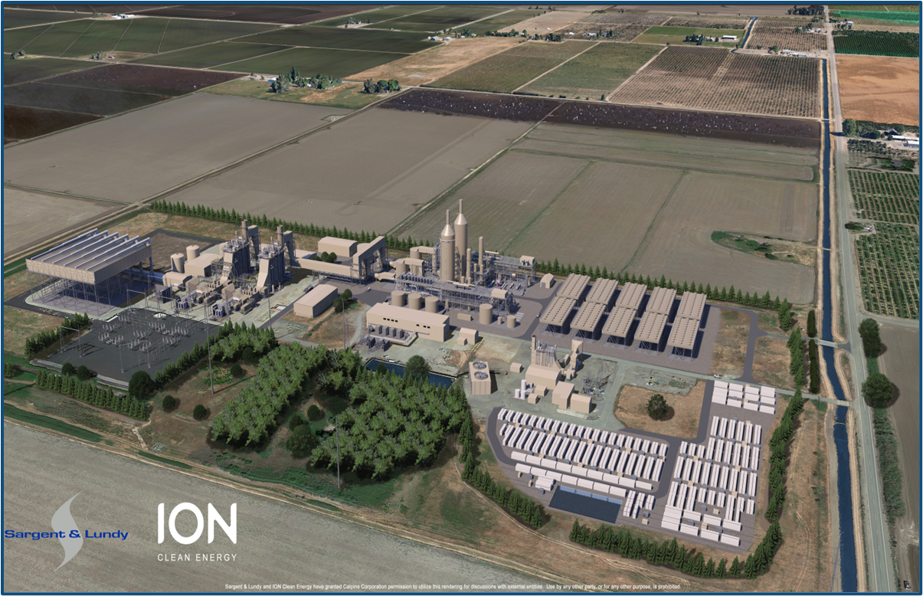
Post Certification Changes to CEC Jurisdictional Power
The Siting, Transmission and Environmental Protection (STEP) Division licenses a power plant 50 MW or more, the project must comply with all provisions of their CEC license.
Per California Code of Regulations Section 1769, if there are any proposed changes to the design, operation, or performance of a licensed project then the CEC must approve that project change before construction can begin.
STEP’s environmental review is a functional equivalent to CEQA’s (California Environmental Quality Act) environmental impact report.

Slide 4
Post Certification Changes to CEC Jurisdictional Power
Power Plant | Post Certification Petition | Approved
Sutter Energy Center | Post combustion carbon capture and storage project. Carbon dioxide will be collected in a first-in-the-world air-cooled capture facility, transported, and permanently sequestered in a geological storage location. | Pending
Los Medanos Energy Center | Demonstration project to test a solvent technology to capture carbon dioxide from a small portion of flue gas from a single turbine exhaust at the power plant. | October 2022
Los Medanos Energy Center | Installation of a flue gas pipe for use in an offsite demonstration project that is manufacturing carbon dioxide sequestration upcycled rock products. | May 2022
Notes:
Post - combustion carbon capture and storage project. Carbon dioxide will be collected in a first-in-the world air-cooled capture facility, transported, and permanently sequestered in a geological storage location.
Demonstration project to test a solvent technology to capture carbon dioxide from a small portion of flue gas from a single turbine exhaust at the power plant.
Installation of a flue gas pipe for use in an offsite demonstration project that is manufacturing carbon dioxide sequestration upcycled rock products.

Slide 5
Resources
Carbon Removal Innovation Support Program: CRISP
Los Medanos Energy Center (98-AFC-01C): Los Medanos Energy Center
Sutter Energy Center (97-AFC-02C): Sutter Energy Center

