Slide 1

Blue Ribbon Committee for the Rehabilitation of Clear Lake
VIRTUAL MEETING PROTOCOLS:
Please note that the meeting is being recorded.
Mute your phone and don’t put it on hold.
For each agenda item, the facilitator will ask for comments from Committee members (facilitator will ask participants to use the “hand raise” feature to enter the queue)
If you have a clarifying question before the staff report is complete, please use the “chat” function
The facilitator will ask for public comments at the end of the meeting.
Meeting #14
April 1, 2021

Slide 2
AGENDA
Welcome and Introductions
Items for Committee Approval
Research Updates
BREAK (AS NEEDED)
2020 Annual Report: Committee Recommendations
Public Comment
ADJOURN
2020 Recommendations Funding Update
Local and Committee Member Updates

Slide 3
Items for Committee Approval
March 1 Meeting Summary

Slide 4
2020 Funding Update
  Update on Proposition 68 Funding Request: $3.5M for select Committee Recommendations:
    Upper watershed modeling and monitoring
    Bathymetric survey
    Continuation of in-lake research
  2021 State Budget update
Notes:
For Prop 68: A total of $4.8M is available to the Committee for projects and actions. Typically, planning and study for projects funded through Prop 68 are limited to 10% of the total amount. HOWEVER: this cap CAN be exceeded in disadvantaged communities, including Lake County. The grant recipient (the organization physically receiving the money) should be a Tribal or Local Agency, but subcontractors can be used. One question: CLERC?

Slide 5
Research Updates
UC Davis Tahoe Environmental Research Center
UC Davis Center for Regional Change

Slide 6
Local and Committee Member Updates
  Cyanotoxin Update- Sarah Ryan, Big Valley Rancheria
  Drinking Water Update- Karola Kennedy, Koi Nation
  Tribal EcoRestoration Alliance (TERA) Update- Terre Logsdon, Scotts Valley Pomo

Slide 7
BREAK
(as needed)

Slide 8
2021 Priorities Exercise
Initial modeling/monitoring results in 2023/24
Approximately $1.3M available for shovel-ready projects*
Initial suggested projects include Kelseyville fish passage and Clove Creek hitch habitat
Where would you like Subcommittees to focus their attention in 2021 (including social/economic issues)?
What are you preferred priorities for interim opportunities before research activities are completed?
*additional funding available depending on 2021 State Budget
Notes:
Committee members will be randomly assigned to 2 separate breakout rooms
Sam will provide links for 2 Miro boards in the chat. Group A will go with Danaka; Group B with Sam.
Participants will be given 10 minutes to generate ideas for near-term priorities by typing on the sticky notes
After initial sticky exercise, participants will discuss suggested priorities in a “popcorn” format for 10 minutes facilitated by Sam and Danaka. Questions for consideration:
Do you have any additional suggestions?
Do you need clarification on any of the existing suggestions?
Can any be combined?
Other?
After discussion, participants will vote for 5 minutes. Each participant can vote for their top 3 priorities (Committee members can use all votes on 1 priority if desired). At the end of 5 minutes, Sam will end breakout sessions and reconvene the group in plenary.
Sam and Danaka will report out findings from each breakout group and share screens to showcase suggestions and voted priorities. After report out, Sam will open for Committee discussion.

Slide 9
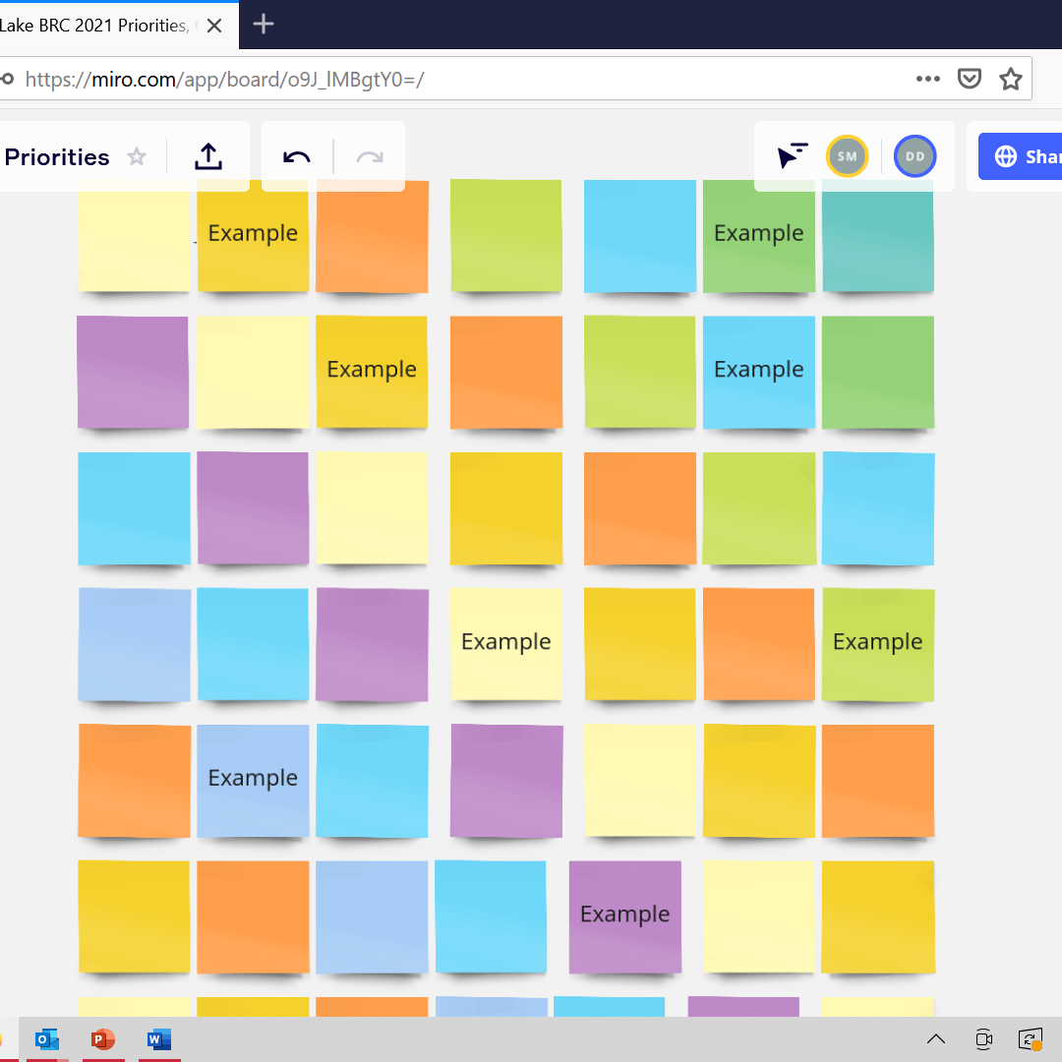
2021 Priorities Exercise
Double click any post it to enter your text
During voting, click on the “plus” to assign your votes
You can select up to three priorities, or assign all of your votes to a single post it!
We’ll reconvene after the breakouts to discuss the results
Notes:
To enter text, double click on any sticky note and type away!
During voting, a small “plus” will appear on the bottom of each post it. You may select up to three post-its as your priority, or assign all of your votes to a single identified priority!
We’ll reconvene after the exercise to discuss the results as a group

Slide 10

Public Comments and Questions
Notes:
NOTE: Agenda items 6 and 4 switched.

Slide 11
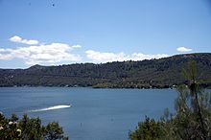
NEXT MEETING: June 23rd, 2021, 1PM

Slide 12
QUESTIONS?
Eric Sklar Blue Ribbon Committee Chair and President of the California Fish and Game Commission eric@preslarventures.com
Dave Ceppos Managing Senior Mediator dceppos@csus.edu | Sam Magill Senior Facilitator s.magill@csus.edu
Danka DeBow Associate Facilitator Danaka.debow@csus.ed

