Slide 1
Blue Ribbon Committee
April 1 ,2021

Slide 2
Center for Regional Change: Deliverables
Lake County region socio-demographic report (final draft presented to SES in April)
Tribal communities and natural disaster planning and recovery (presentation today; report draft presented to SES in April)
Regional Disaster Planning and Recovery issue brief and white paper (draft presented to SES in April)
Economic development issue briefs (presented to SES in April)
  Environmental education
  Youth and workforce development
  Broadband development
  Agricultural and natural resource tourism
All deliverables submitted by June 2021

Slide 3
Five Core Areas to Support and Promote Recovery to Natural Disasters: Insights from Tribal Communities in the Clear Lake Region
Anne Visser, PhD, UC Davis CRC
Clare Cannon, PhD, UC Davis CRC
Leslie Panyanouvong, UC Irvine

Slide 4
Overarching Goals of Report:
To offer to a broad audience an understanding of challenges to disaster recovery identified in the Clear Lake Region;
To highlight 5 Recovery Core Areas for Tribal nations and communities as well as other stakeholders in the Clear Lake Region;
To provide a list of resources available from the University of California to address disasters and support community resilency.

Slide 5
Methodology
1) content analysis of the available literature on the topic;
2) stakeholder interviews with tribal government representatives, members of the Blue Ribbon Commission and other agencies that serve tribal nations in the Clear Lake Region
3) quantitative and qualitative data analysis on the content analysis and interviews to identify 5 core recovery areas for tribal nations in responding to natural disasters in Lake County.

Slide 6
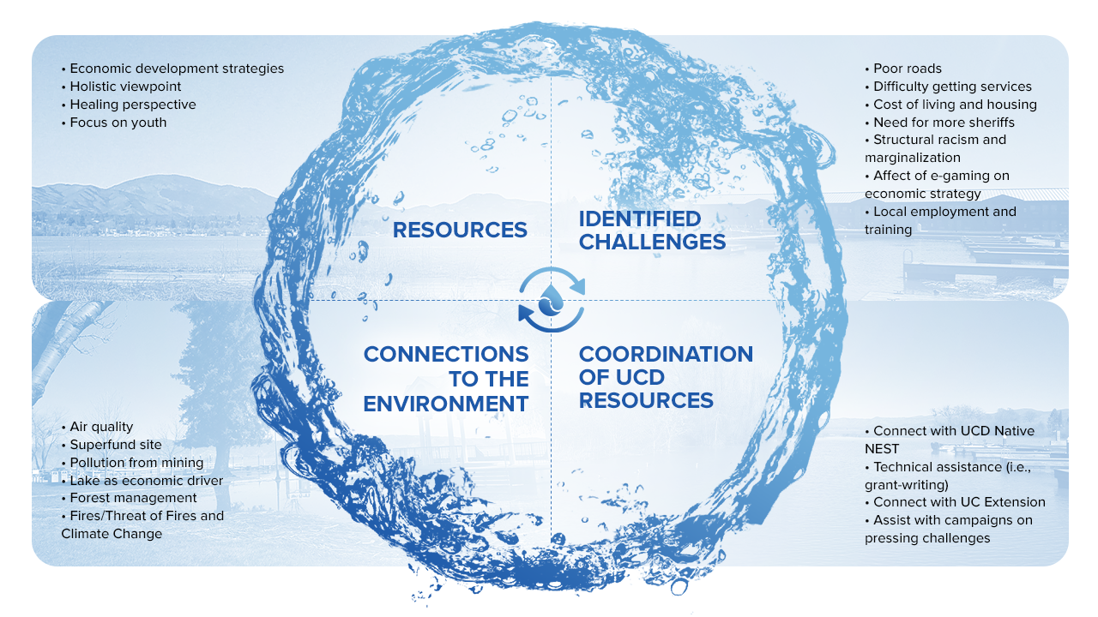

Slide 7
Economic Recovery | Return economic and business activities to a healthy state while supporting the development of new business and employment opportunities that promote economic viability.
Health Care and Social Services | Restore and improve health and social services capabilities and networks to promote the resilience, independence, health and well-being of residents.
Housing | Implement housing solutions that effectively support and contribute to sustainability, resilience, and affordability for the community as a whole.
Infrastructure Systems | Stabilize critical infrastructure, minimize health and safety threats, and efficiently restore and revitalize systems and services.
Environmental Stewardship | Protect natural and cultural resources through appropriate planning, mitigation, response, and recovery actions to preserve, conserve, rehabilitate, and restore them.

Slide 8
Critical Areas to Support Recovery
Economic Recovery | Identify potential inhibitors to fostering stabilization post-disasters Implement recovery strategies to facilitate robust problem-solving among economic recovery stakeholders Remove barriers to post-disaster economic resilience
Health and Social Services | Identify potential and actually affected populations, groups and key service provider partners in recovery and recovery planning efforts Monitor and continue to assess community health and social service needs Protect the health and safety of recovery workers during and post-disasters
Housing | Assess interim housing needs Assess and identify options for permanent housing during pre and post disaster recovery for tribal community members

Slide 9
Critical Areas to Support Recovery
Infrastructure Systems | Support community engaged pre disaster recovery planning that includes tribal governments at the regional and system wide level Leverage resources available in the community and externally for tribal governments to support and build capacity
Environmental Stewardship | Facilitating direct experiences with nature and connecting/reconnecting identity in relation to nature Connect values, actions, and outcomes to environmental stewardship and ensure options for the protection of environmental resources have been explored and implemented to the maximum extent possible

Slide 10
Pre-Disaster Planning Areas for Action
Identify ways to build upon existing plans and initiatives
Conduct a vulnerability analysis
Identify and assess recovery capacity
Establish recovery priority areas
Adopt recovery ordinances
Continual update of the Hazard/Mitigation Plans

