Slide 1
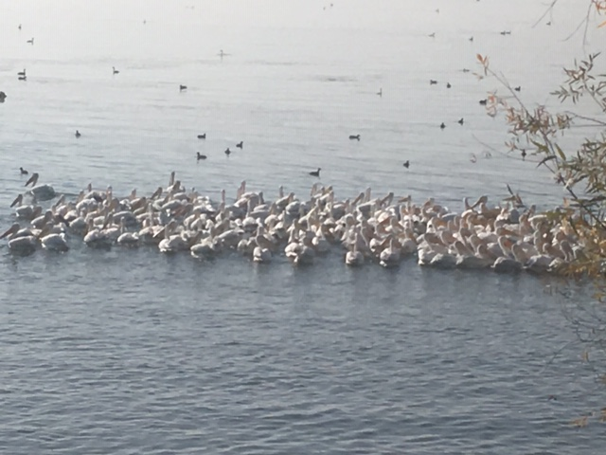

Slide 2
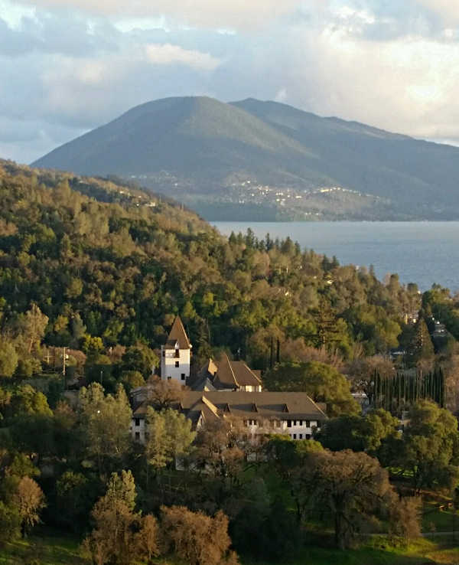

Slide 3
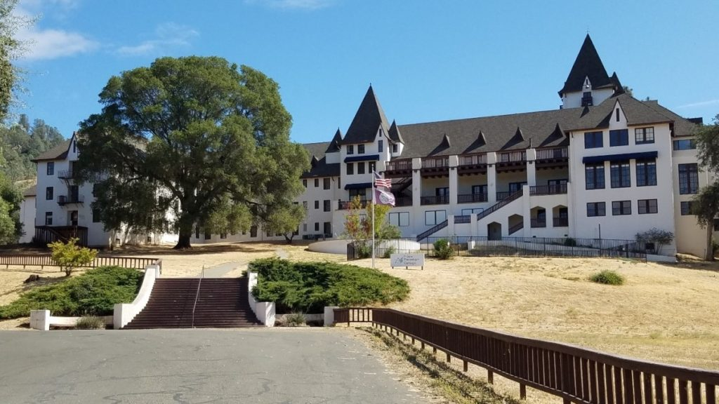

Slide 4
Lake County Fresh-Water Laboratory
30 years of research has not resulted in a management plan. Present recommendations are for more research and monitoring.
Monitoring is a feedback loop of a management plan.
A local lab for local requirements will support a unified plan.
The Lucerne “Castle” has been designated for college/community conference center.
Local, research and teaching needs would support operational costs.
The Castle vision would focus all efforts to rejuvenate the region.

